Slide 1
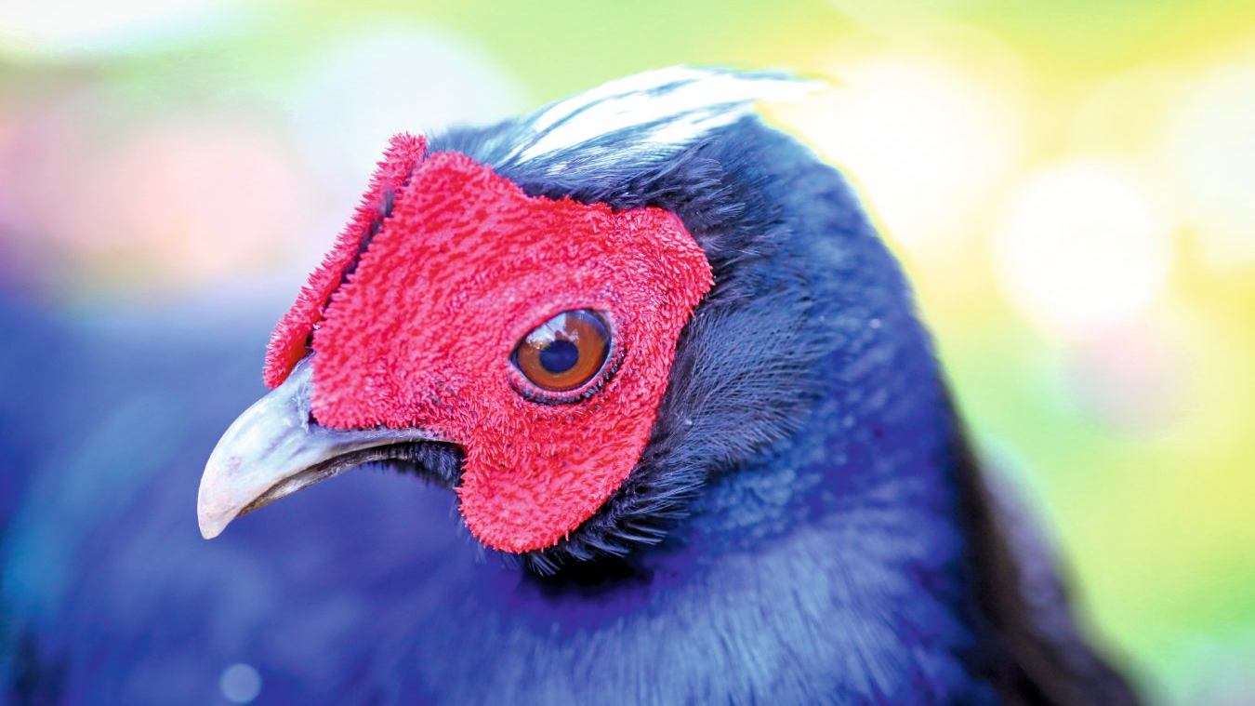
Study into the behaviour of Lophura edwardsi and the effect of observer presence on their display.
Rhiannon Hoy
UoP880299
(Davies, 2017)

Slide 2
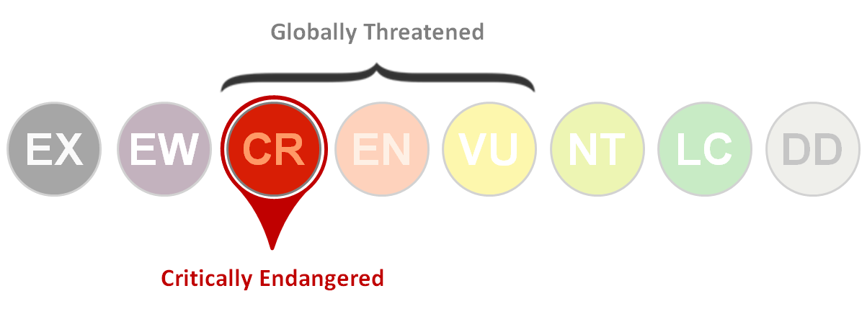
Why Edwards’s pheasant?
(BirdLife International, 2019)
(Hennache, 2014)
Notes:
Edwards’s pheasant population trend is shown as decreasing, with an estimated 50-249 remaining in the wild (BirdLife International, 2019).
Their population range is small and severely fragmented due to the loss of lowland habitat throughout the Vietnam war (1955-1975) and pressures from high level hunting. (10 recorded sites between quang tri province and thua thein hai province… others discovered by Delacour between quang tri to hoi an province)
Due to which, the IUCN has deemed the species critically endangered and of conservation concern (Hennache, 2014).
However, Jean Delacour removed remaining birds they captured to Europe in 1920 and began breeding them (European Conservation Breeding Group, 2014)… then in 1968, the first studbook was established for a more efficient breeding programme (World Pheasant Association, 2014).
BUT little is known of the birds, their natural behaviour and what influences breeding success.
Therefore… as Sparsholt and Paignton Zoo are working in partnership with EAZA & Viet Nature to reintroduce the pheasants (Paignton zoo, 2019) I wanted a project of impact, to help conservation and to develop beneficial research.

Slide 3
AIMS
To develop an understanding of the behaviours displayed by Lophura edwardsi, assess Lophura edwardsi use of enclosure space in correlation to the performance of behaviours and investigate whether observer presence has an influence on the expression of behaviours.
(Wild Planet Trust, 2019)
Notes:
Understand the behaviours of L. edwardsi
If there is a correlation of enclosure use and performance of behaviours (do they show a habitat preference?)
Investigate whether there is an influence of observer presence on behaviour

Slide 4
Notes:
A survey will be included; sent out in WPA newsletter with the aim that breeders will complete.
Investigating; enclosure design, chick success – hoping to highlight any relationships between enclosure design and breeding success.

Slide 5
HYPOTHESES
H1₁ There will be a significant difference in the behaviours displayed by L. edwardsi when the observer is present and the observer is not.
H1₂ There will be a significant correlation between enclosure use and the presence of behaviours.
(Buccelli, 2018)
Notes:
OVERALL my study can be seen as a pilot study … gathering general information on the behaviour of l. edwardsi.
H1: There will be a significant difference in the behaviours displayed by L. edwardsi when the observer is present and the observer is not.
H2: There will be a significant correlation between enclosure use and the presence of behaviours.

Slide 6
LITERATURE
Notes:
Research is limited in captive L. edwardsi and non-exsistent in the wild due to the lack of populations and study interest.
Current literature, specifically the WPA husbandry guidelines (Hennache, 2014), only briefly state the breeding and courtship behaviours of the species.
We do understand that; a breeding pair will nest on the ground, enter breeding season at the end of March (Dams, 2018) and produce a clutch of between four-seven eggs (Hoyo, Elliott & Christie, 2011).
From what is known of l. edwardsi in the wild: they are associated with thick undergrowth and assumed to have similar activity budgets to other forest-dwelling pheasants e.g. spending morning-late afternoon foraging and roosting in trees overnight (Johnsgard, 1999).
Therefore, assuming I will find similar results for those at the Sparsholt amc but, more detail needed on the activity budget

Slide 7
METHODOLOGY
72 hours
Enclosure zones
Instantaneous focal sampling
Extraneous variables
(ePHOTOzine, 2016)
Notes:
72 hours of data collection was carried out across 2 aviaries.
36 hours at each enclosure; both divided between camera (18hours) and physical observations (18hours)
Samples: 1 aviary containing a breeding pair and 6 chicks, another aviary with a breeding pair and 2 chicks.
I sectioned the enclosure into zones (indoors, dense vegetation, open land and elevated perch) to allow for assessment of habitat preferences.
Behaviours of both the female and male parents were recorded every minute for one hour periods, alongside their location in the enclosure.
Chick location was also recorded but, behaviours were not counted due to the inability to identify individuals.
Extraneous variables were recorded to allow them to be controlled (Martin & Bateson, 2006); date, time, weather, temperature, visitors and keeper presence.

Slide 8
RESULTS AND INDUSTRY APPLICATION
(Bezodis, 2015)
Notes:
Not all data has been analysed yet, therefore no statistical results can be concluded.
However, from raw data and observations = It appears that L. edwardsi spend the majority of their activity budget foraging in the open land and under dense vegetation.
= When an observer is present, they spend more time out of site or under dense vegetation. Whereas, camera observations show the birds as being in open land for the majority of the observation period.
=*an interesting observation is that both breeding pairs have started to re-establish bonds during the months of October and November, with the males grooming females and performing courtship behaviours (male wags tail side to side while female bows). Potentially suggesting that captive pairs establish bonds months before the breeding period begins in March (European Conservation and Breeding Group, 2014).
Application to the industry = overall aim will be to use this information to promote appropriate husbandry care throughout collections in the breeding programme and therefore, have a knock-on impact on the success of birds bred and released as their needs will be better understood.
Specific examples: the observation that birds spend the majority of time foraging – requires them to be given substrate appropriate for this behaviour and/or scatter feed their supplement feed (mealworms) to encourage foraging (Hennache, 2014).
*With the observer having an effect on the birds’ behaviours – keepers performing husbandry routines would need to be aware of this and be considerate when entering enclosures (e.g. allowing birds time to hide and escape their presence).
*Bonds being re-established during winter months may suggest that pheasant pairs should be introduced before the breeding period to ensure pairing is a success.

Slide 9
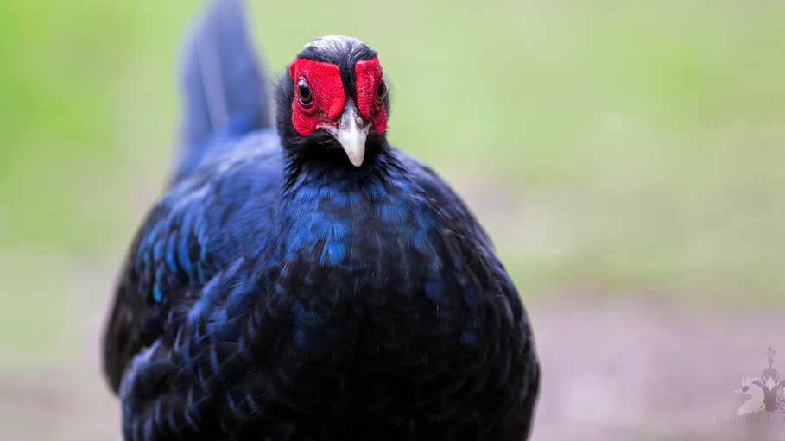
Questions?
(Blue Creek Aviaries, 2019)

Slide 10
References
Bezodis, W. (2015). Edwards’s pheasant [image]. Retrieved from https://www.zoochat.com/community/media/edwards-pheasant.292645/. Last accessed 04.12.19.
BirdLife International. (2019). Species factsheet: Lophura edwardsi. Retrieved from http://datazone.birdlife.org/species/factsheet/edwardss-pheasant-lophura-edwardsi. Last accessed 03.12.19.
Blue Creek Aviaries. (2019). Edwards’s Pheasant [image]. Retrieved from https://www.bluecreekaviaries.com/edwardss-pheasant. Last accessed 04.12.19.
Buccelli, D. (2018). Birdy Spotlight: Edward Pheasant [image]. Retrieved from https://zootampa.org/birdy-spotlight-edward-pheasants/. Last accessed 03.12.19
Dams, J. (2018). Edwards’s pheasant (Lophura edwardsi): Strategic conservation planning workshop for Edwards’s pheasant [pdf]. Retrieved from http://aviansag.org/TAG/Galliformes/Edwards%27s_pheasant_JDEdinburgh.pdf. Last accessed 04.12.19.
Davies, N. (2017). Can we bring back the pheasant that was wiped out by the war in Vietnam? [image]. Retrieved from https://www.birdlife.org/asia/news/can-we-bring-back-pheasant-was-wiped-out-war-vietnam.Last accessed 03.12.19.
ePHOTOzine. (2016). Choosing binoculars for bird photography [image]. Retrieved from https://www.ephotozine.com/article/choosing-binoculars-for-bird-photography--29036. Last accessed 03.12.19.
European Conservation and Breeding Group. (2014). Edwards’s Pheasant. In World Pheasant Association (Eds), The International Newsletter of the World Pheasant Association (N95, pp.12-13).
Hennache, A. (2014). World Pheasant Association: Husbandry Guidelines Lophora edwardsi [pdf].
Hoyo, D. J., Elliott, A., Christie, D. (2011). Handbook of Birds of the World. Barcelona: Lynx Edicions.
Johnsgard, P. A. (1999). Pheasants of the World (2nd ed.). Shrewsbury: Swan Hill Press.
Martin, P., & Bateson, P. (2006). Measuring Behaviour An introductory guides (2nd ed.). Cambridge: University Press.
Paignton Zoo. (2019). Hatching Plans for the Future of the Species. Retrieved from https://www.paigntonzoo.org.uk/explore/news/detail/hatching-plans-for-the-future-of-the-species. Last accessed 04.12.19.
Wild Planet Trust. (2019). Husbandry and breeding in Vietnamese pheasants [image]. Retrieved from https://www.wildplanettrust.org.uk/research-projects/husbandry-and-breeding-in-edwardss-pheasants/. Last accessed 03.12.19.
World Pheasant Association. (2014). Cover Picture. The International Newsletter of the World Pheasant Association, 93 (Spring edition), 2.

